Slide 1


Coaching and Communicating with Diverse Teams

Slide 2
Why are we here?
Diversity
Communication and Coaching
Tools and Best Practices
Notes:
Outside of the agenda, there are three main points to keep in mind:
Today we’ll cover various labels associated with groups of people across age, behavioral norms, etc. None of the topics today are to be considered negative or a bad trait to possess. In fact, these attributes that we’ll discuss are exactly why diverse teams are so important and yield the invaluable benefit of the diversity of thought.
NO ASSUMPTIONS. The evidence presented for today’s session is based in various researched studies over time to support trends for various labeled groups. The goal of this talk is to bring awareness about how certain groups of individuals may gravitate towards certain methods of communication, coaching, rewards, etc. However, you should never assume, get to know people as their individual selves and learn what works best when engaging with them.
I have created user personas for the purpose of helping bring the future scenarios we’ll cover to life. The personas themselves are complete fictional characters. Their personal profiles pictures and images do not reflect past or current AWH employees. I will be sure to highlight when I am speaking on an actual AWH tool or process, otherwise, you can assume all scenarios are relatable but fictional.

Slide 3
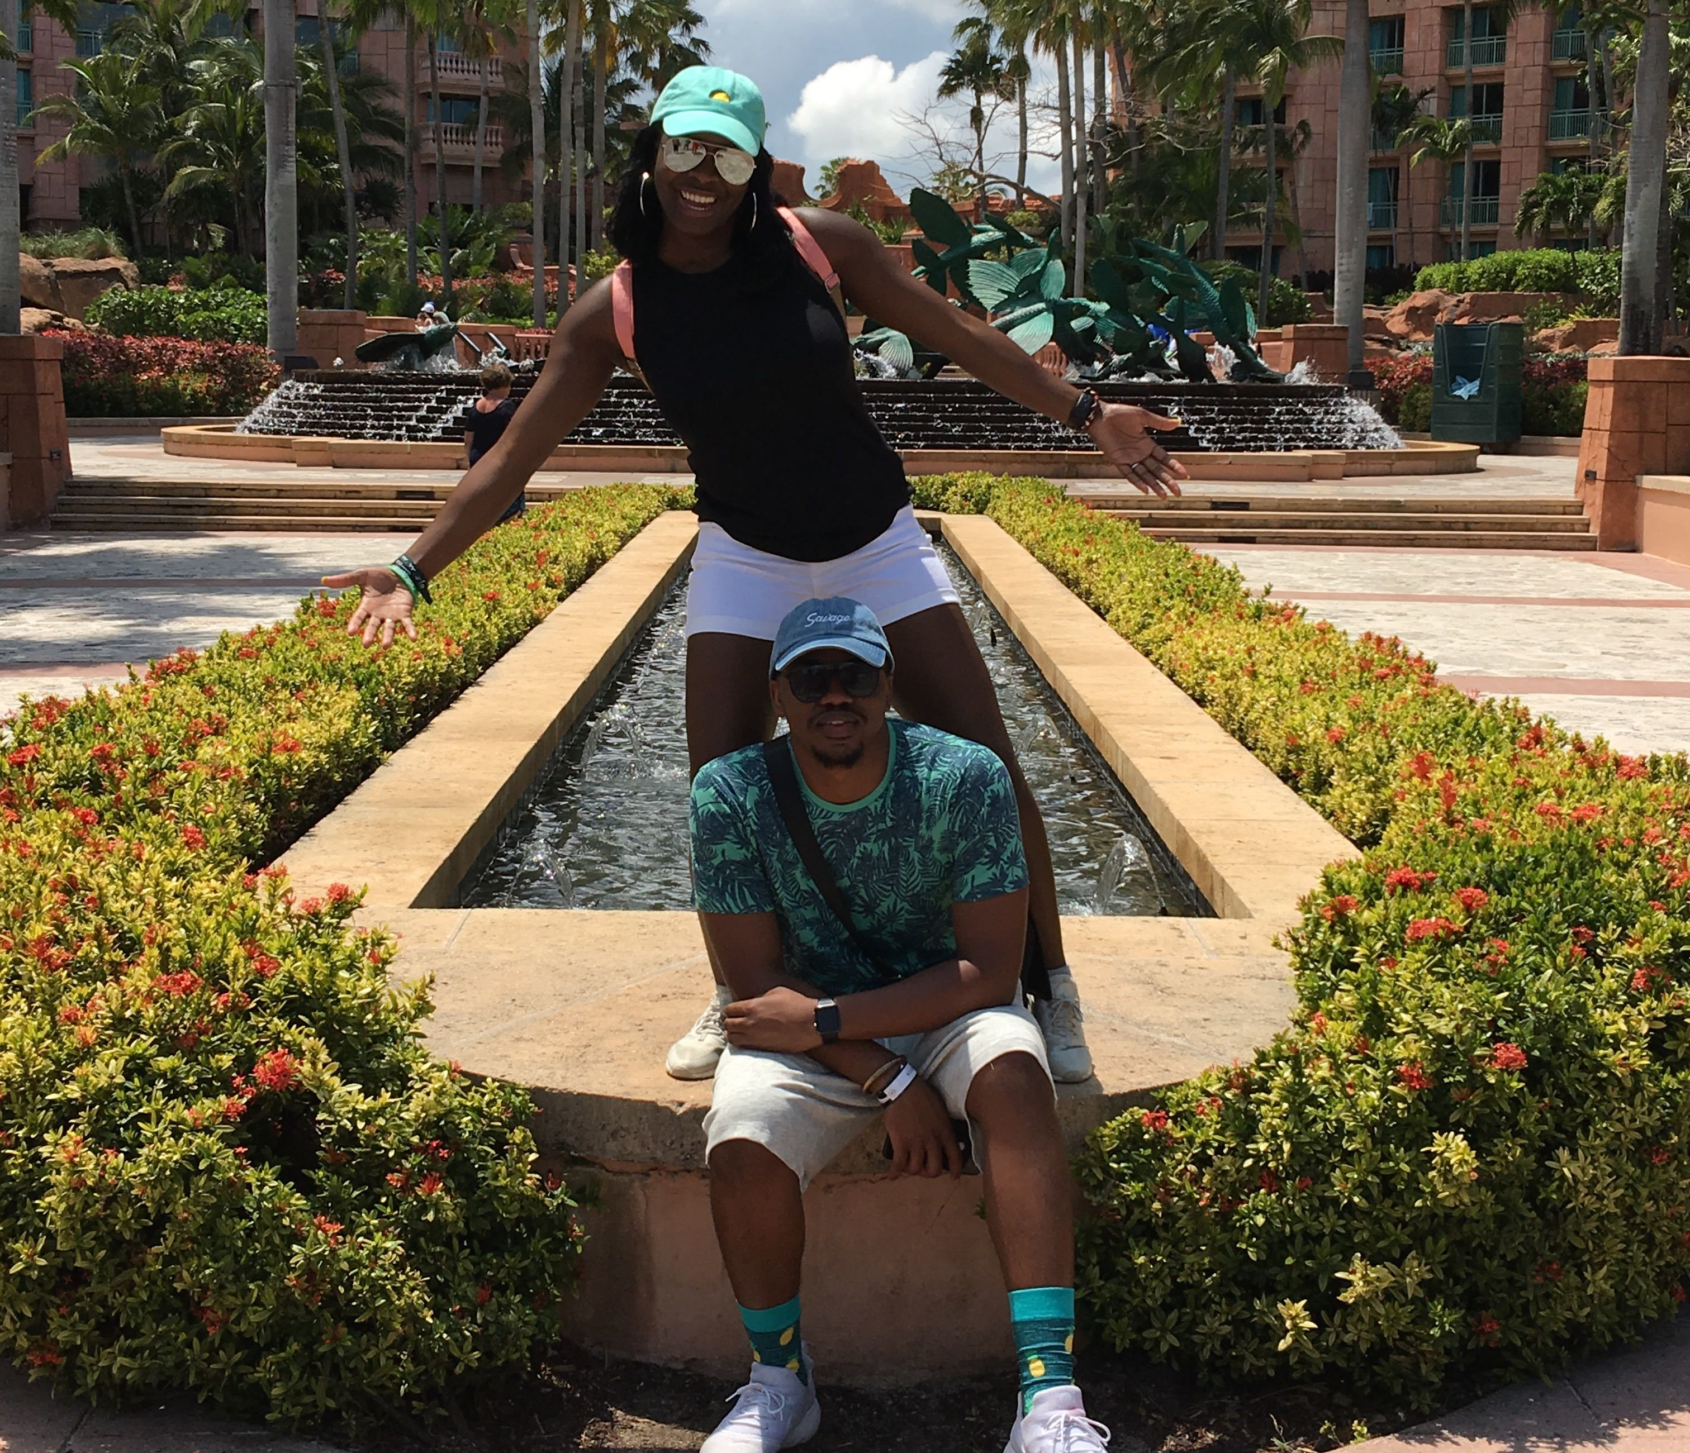
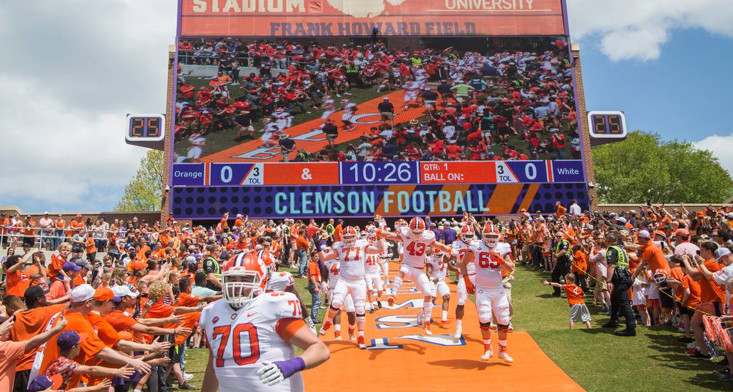

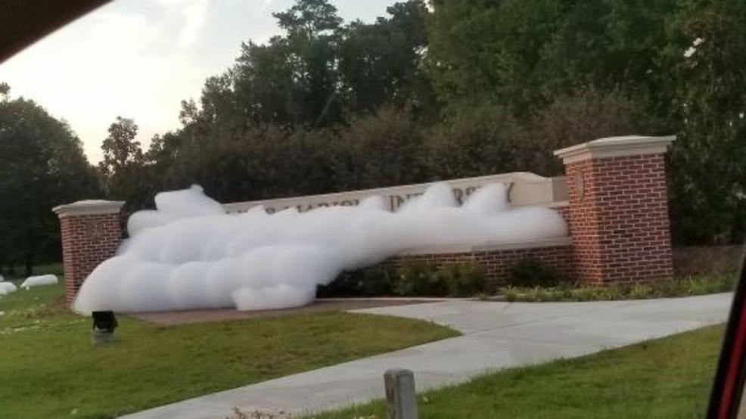
Notes:
About Me:
I’m Kiera and I’d classify myself for the purposes of this talk as a control-centric, ambivert, millennial Virgo.
Recently engaged so work life balance is more important than ever to me now and shows up for me as a reward from employers.
Clemson alum – as a woman of color attending a PWI, I was often the “only” in many of my classes, some extra curriculars, and at events with members of leadership who oftentimes didn’t look like me or share similar experiences. I had to learn to find ways to communicate with others who may not share the same life experiences, think or approach issues the same.
From a small town in South Carolina. As a child and young teenager I grew up where having manners, many times crossed over into not challenging, speaking against, or voicing my own opinions in to elders or those in positions of authority. I’ve had to learn to adjust my mindset and find my voice to communicate with leaders, support my decision-making and other ideas, and disagree/commit respectfully when the time called for it.

Slide 4




AWH Team Personas
Notes:
During to

Slide 5



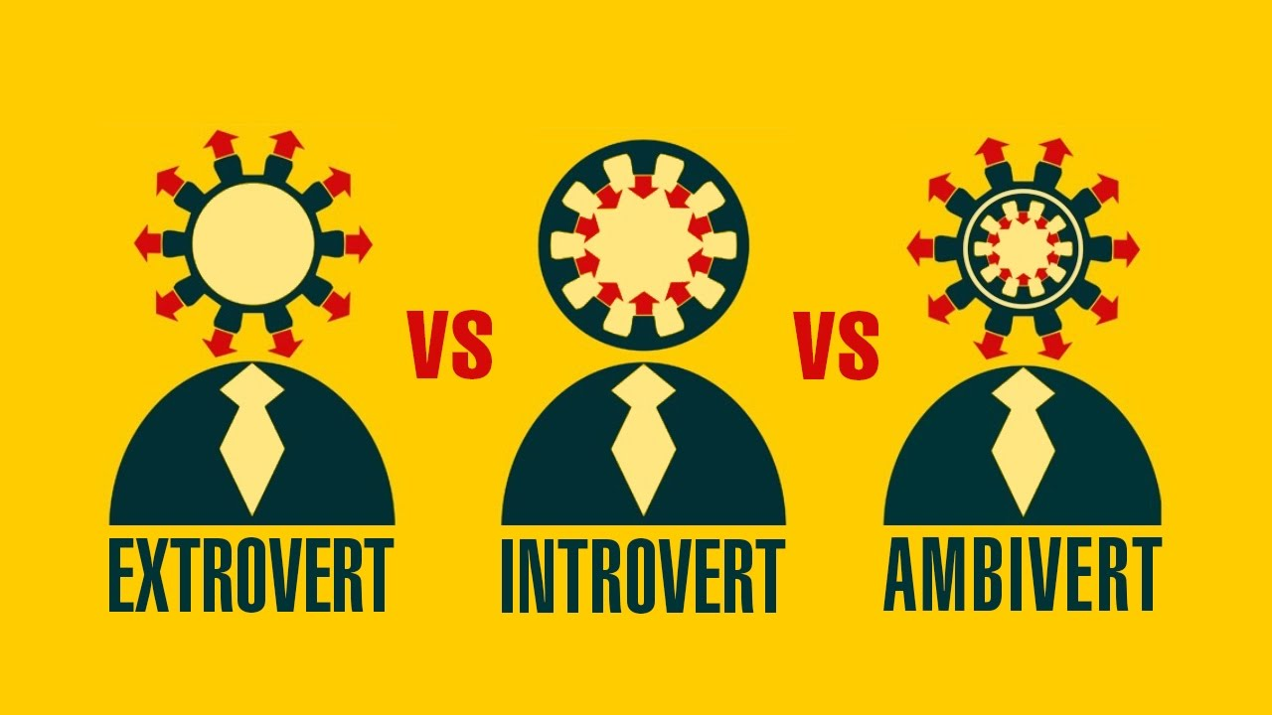




Let’s Talk Diversity. AGAIN.

Slide 6
Jason - Managing Partner
32
Millennial
Personality: extrovert, results-oriented
Motivations: impact, innovation, teamwork, community
Frustrations: infrequent and indirect communication, unclear goals, lack of ownership

Slide 7
Kevin - Director of Product Development
43
Generation X
Personality: ambivert, engaging, patient, thorough, customer-centric
Motivations: authenticity, open communication, quality results through teamwork
Frustrations: poor communication, short-term gains over quality results

Slide 8
Vineeth - Senior Software Developer
62
Baby Boomer
Personality: introvert, direct, methodical, professional
Motivations: support family, career advancement
Frustrations: disregard for organizational hierarchy, low face-to-face engagement, dynamic fast-paced environments

Slide 9
Desiree - Software Developer
24
Millennial
Personality: extrovert, competitive, results-driven, direct
Motivations: competition, challenge, exceed goals, presenting
Frustrations: indirect communication, low energy and interaction, barriers to accomplishments

Slide 10
Andrew – Junior Software Developer
22
Millennial
Personality: introvert, problem-solver, methodical
Motivations: complex problem-solving, individual work assignments
Frustrations: large group meetings, public speaking, impromptu activities

Slide 11
Scenario #1
Themes:
Building diverse teams
Generational diversity
AWH is in growth mode and Jason is building a team of diverse digital product creators.

Slide 12

Building Diverse Teams
Start with recruiting
Hire for a cross-section of technical and soft skills
“Culture fit” can kill innovation
Notes:
Recruiting
Monitor job ads for bias terminology and descriptions
Expand sourcing outreach to areas that will reach a more diverse pool of talent – conferences, meetups, bootcamps, etc.
Hire for tech and “soft” skills
Behavioral questions that evaluate leadership, ownership, teamwork, etc.
Real interview scenarios to observe a candidate in a work-like setting – example: AWH coding exercise and code review in lieu of a normal 1:1 Q&A interview
Culture fit may give way to implicit bias, hiring similar individuals can minimize cognitive diversity thus killing your innovation engine – aka. your team as individuals together

Slide 13
Is your team TOO Diverse?
AWH Core Values
Awesome Comes Standard
Results Focused
Stay Curious
Transparent
Deliver
Own Selflessly
Situational Awareness
Integrity
Notes:
Adding a ton of individuals across various races, backgrounds, genders, etc. does not necessarily equate to value-added diversity if there is no synergy amongst the group. Hire for diversity but assess candidates according to their alignment to your company’s core values, mission, goals, etc. That way the “culture fit” is rooted in driving your company forward.

Slide 14
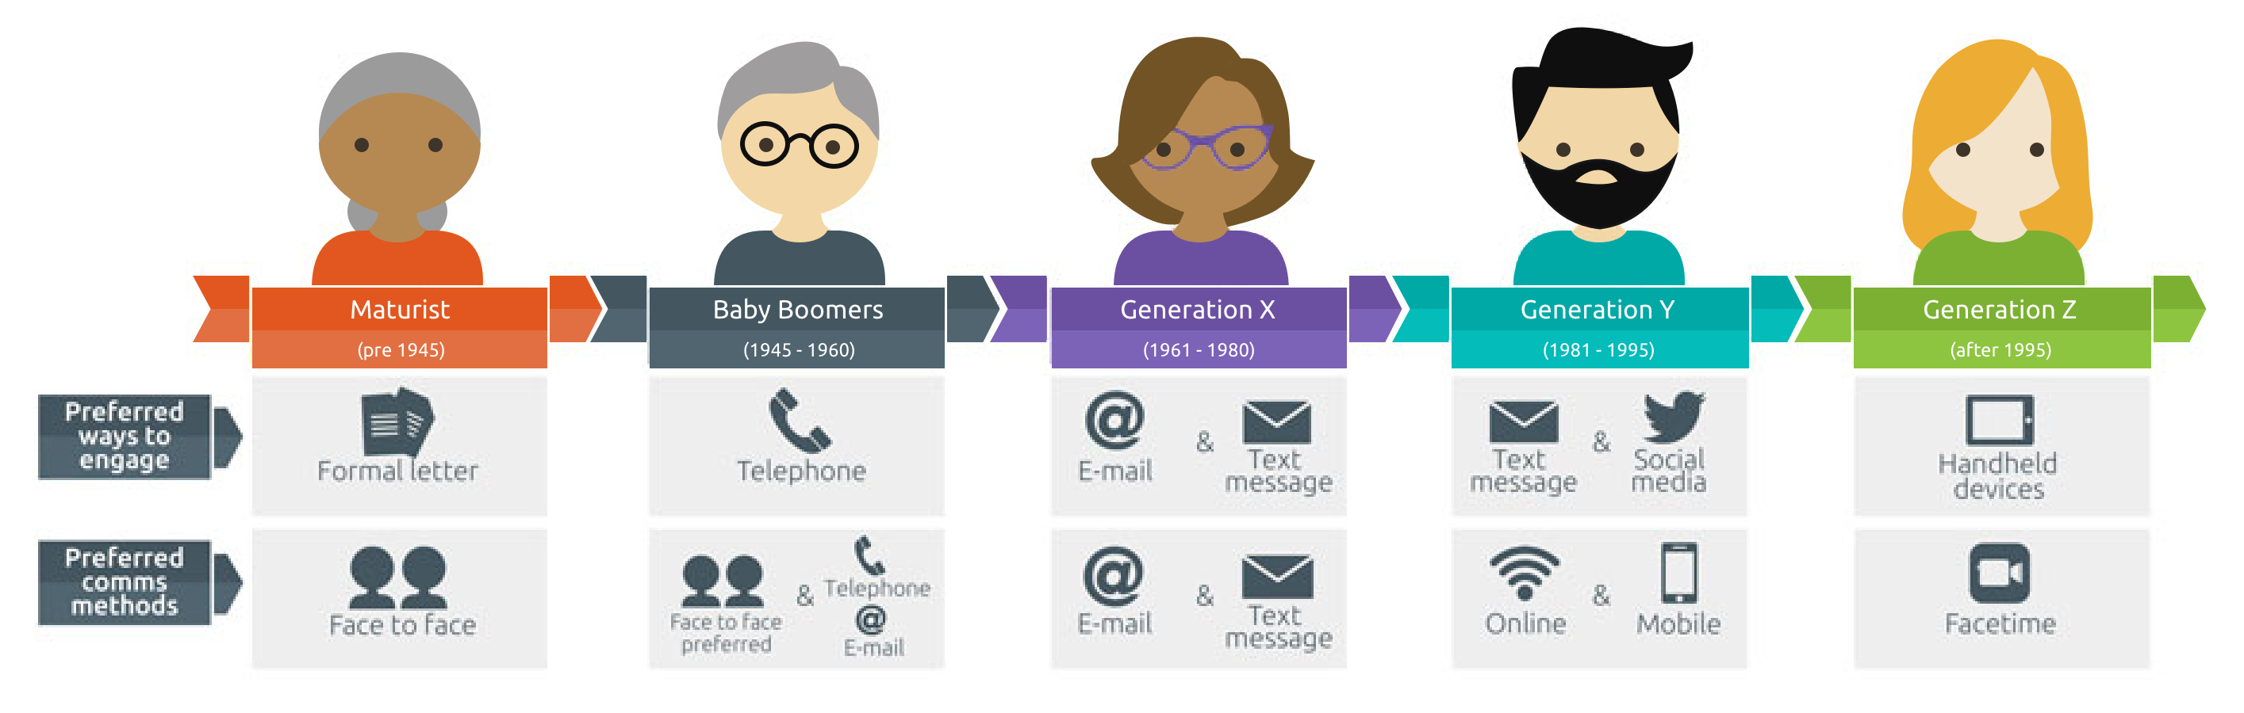
Generational Diversity
Tenure vs. level of experience
Preferred working styles
Communication preferences
Notes:
Tenure is NOT the same as level of experience a team member brings to the table. Ask the right questions to understand how someone’s years or lack thereof show their progressive ownership and growth in their respective positions. Do you bring them onboard and how to coach through their areas of opportunity.
Working Styles:
Baby-Boomer:
Work is priority – will often work long hours for visibility, to show their value, to get goals accomplished
Will not blindly follow authority – explain the WHY
Gen X:
Core group to introduce work-life balance. They are paid to do a job but not live there
Values having trust from their manager to work independently without micromanagement
Wants control of their career path
Gen Y (Millennials)
Work-life harmony; remote; flexibility in schedules
Teamwork, visibility, and challenge
Communication Preferences:
See image

Slide 15
Coaching & Recognition - Multigenerational Teams
Baby Boomers:
Why
Documentation
Public recognition for time & value
Engage w/leadership
Gen X:
Regular feedback, avoid micromanaging
Personal control over career path
Reward results not time
Free time
Gen Y (Millennials):
Seat at the table - ideas, creativity, innovation
Frequent “real-time” communication – positive or actionable constructive
Change: frequent and ascending project ownership

Slide 16
Scenario #2
Themes:
Cultural scripts
Kevin and Vineeth are meeting for their first official 1:1 to discuss how Vineeth is adjusting to the role.

Slide 17
Cultural Scripts Case Study
China – Doctrine of Mean and Harmony | China – Mianzi | India – Apane Log and Social Hierarchy
Social harmony – avoid confrontation Respect authority | “Save face” to maintain social standing | Strong social relationships Leaders drive, subordinates follow
Safe space Less formal, more open environments Anonymous Feedback (Wikis) Balance within social relationships
Notes:
Key Points:
Cultural scripts can pose a challenge for how employees engage and communicate in the workplace.
Chinese and Indian cultures observe similar scripts in which nurturing social relationships, respecting authority/leaders/hierarchy make it difficult for employees to have open dialogue that contradicts or challenges their peers and leaders, especially in formal settings.
In the case study where agile was being implemented in these groups, leaders began to implement the following strategies
Create a safe space in your work environment to “unlearn or adjust” mindsets, encouraging your teams that healthy dialogue – even in disagreement, is helpful to the success of the agile process
Less formal ways to engage leadership – breakrooms, happy hours, wikis, etc.
Explain that having strong social relationships does not negate the fact that there are times feedback must be delivered and it’s not personal

Slide 18
Scenario #3
Theme:
Introvert and extrovert dynamics
Andrew recently joined a project team with Desiree. She has growing frustrations that Andrew rarely provides input during routine team meetings.

Slide 19
Introverts and Extroverts
Understanding + empathy = synergy
Small teams
Provide opportunities to process information and vocalize feedback
Analyze tools, processes, and meetings
Harmonize work environments

Slide 20
Managing Diverse Teams
Know your people – as people.
Secure space to “challenge everything”
Highlight proficiencies, nurture opportunities, and respond to desires
Align to core performance and behavioral expectations
Notes:
Building relationships, builds trust. It gives you the opportunity to learn your teammates as individuals, their triggers, motivations, etc. Healthy evidence to adjust how you engage them as people.
Diverse teams will often times result in diversity of thought – which is great! However, leaves space for conflicting discussions to occur. Ensure these conversations are being done with respect, opinions are encouraged, and someone of authority in that space can bring about a decision if conversations turns unproductive.
The last two bullets will be further explained on upcoming slides.

Slide 21
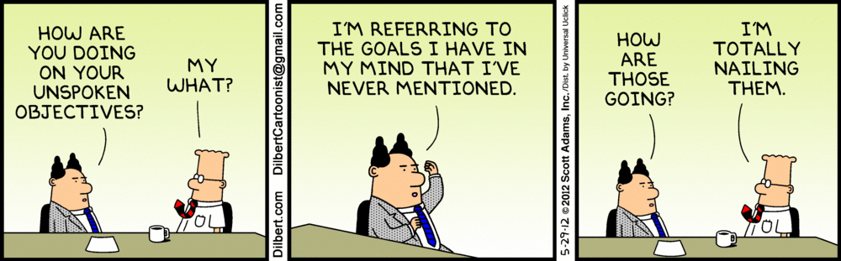
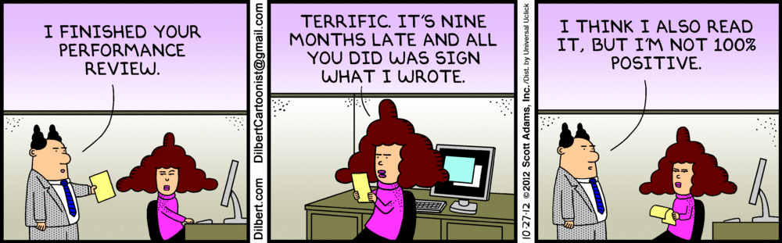

Slide 22
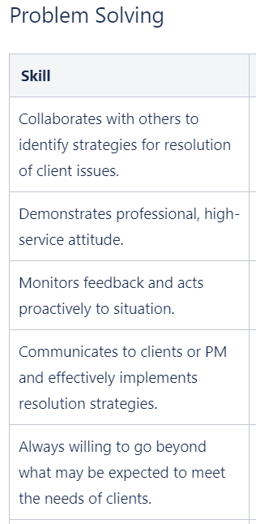
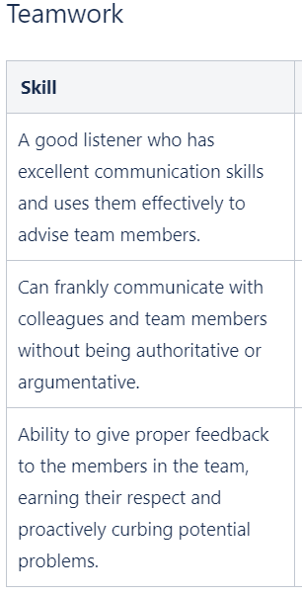
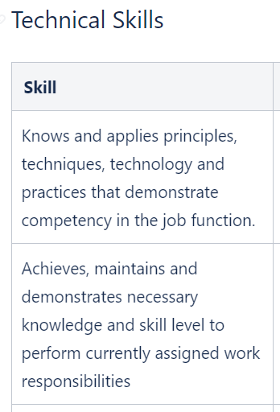
Notes:
These are snippets from the AWH Developer Evaluation form – full PDF available on my LinkedIn.
Key Points:
Documentation – thorough, clear, and consistent
Consistent Measurables – evaluations for your employees should be aligned to foundational benchmarks/measurables that reflect company values, mission, goals as a company and expectations for team members
Manage to the one – your employees are held to consistent expectations but HOW they perform to the expectation may vary based on the individuals
Example:
Core Expectation: Problem-Solving
Specific Skill: Demonstrating professional, high-service attitude
Desiree who is a more extroverted personality may show her high service attitude through open dialogue with peers, having conversations with clients when applicable, and taking quick action on requests. While Andrew who is more introverted may show his high service attitude through thorough documentation, deep diving into problems, and providing written solutions or feedback in 1:1 settings. Both meet the measurable for the skill under problem solving but due to their individual nature, it shows up to the manager differently.

Slide 23

AWH Developer Evaluation
Highlight Proficiencies | Nurture Opportunities | Respond to Desires | Additional Feedback
Notable Accomplishments | Areas for Growth | Future AWH Career Goals | Preferred Feedback Delivery
Strengths & Preferences | Issues or Challenges | Areas of Interests (projects) | Team Interactions
Key Points: documentation, consistent measurables, manage to the one

Slide 24
Co-location & Remote Teams
Support remote work
Drive constant & clear communication
Drive accountability
Promote cohesion

Slide 25
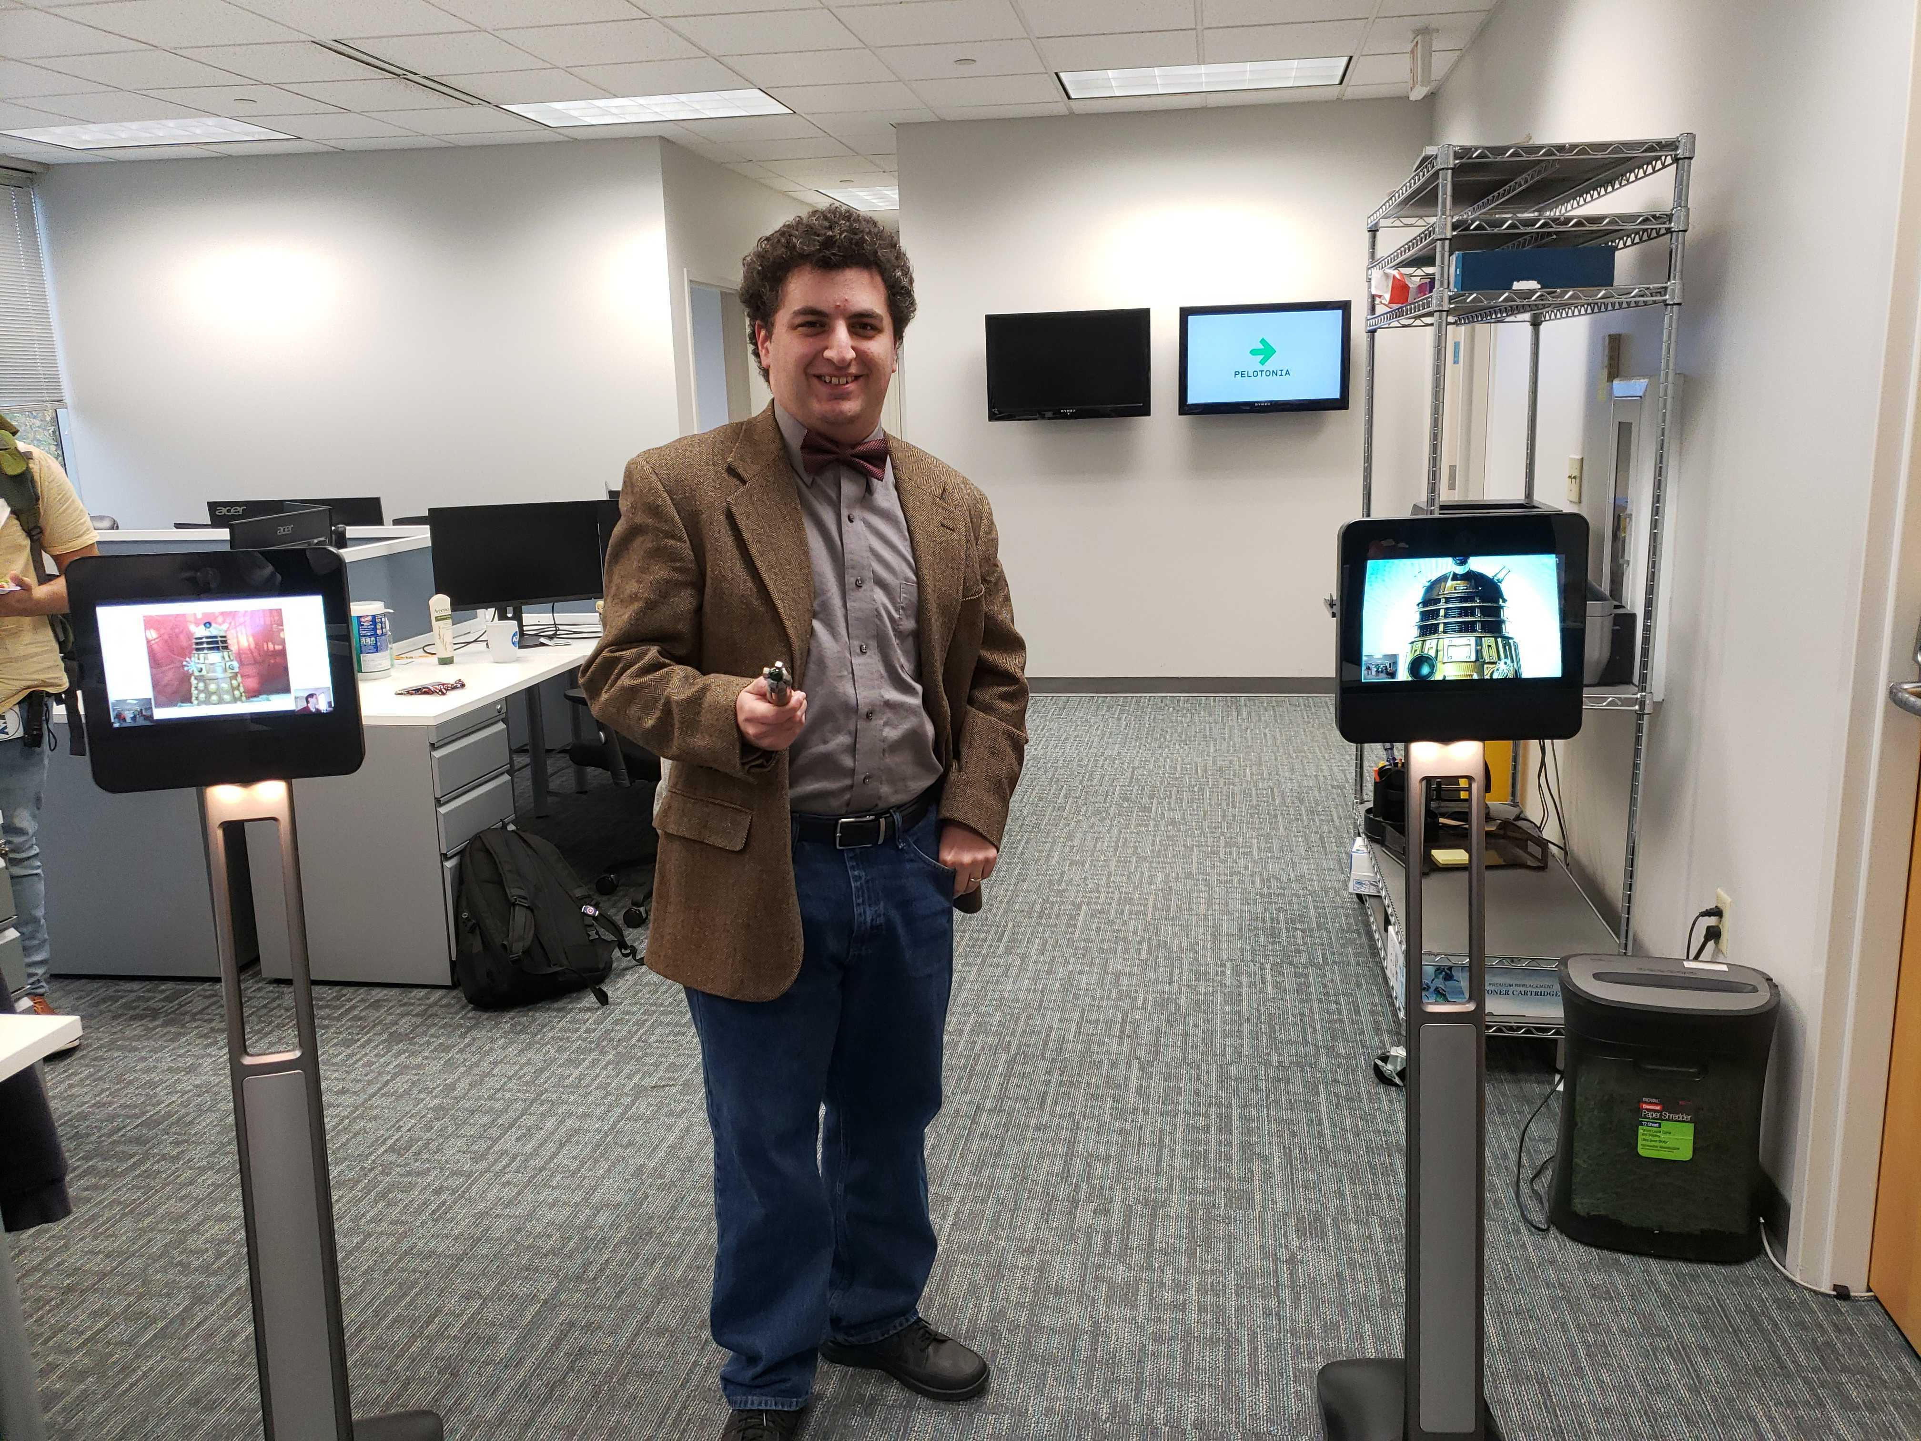
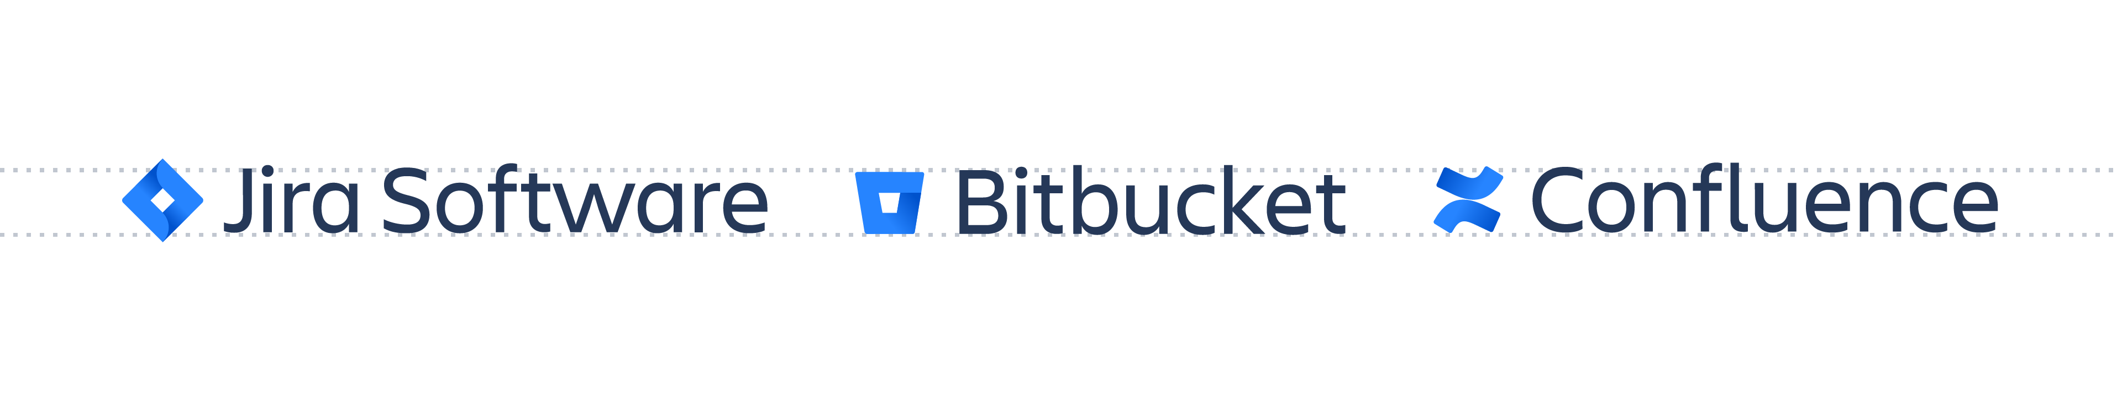
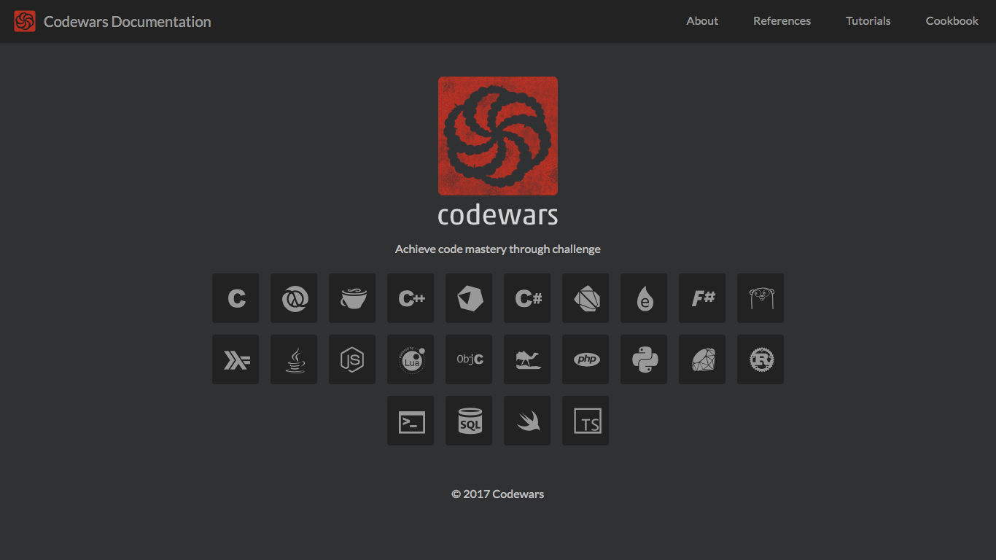


Slide 26

Key Takeaways
No assumptions.
Build relationships first and always.
Tools and processes are adaptable.
Manage to the one w/consistent measurables.
Diversity = innovation.

Slide 27

Let’s Chat!
Kiera Prioleau
Career Developer & Technical Recruiter @ AWH
kiera.prioleau@awh.net
https://www.linkedin.com/in/kieraprioleau/
#BeGreat

Slide 28
References – Articles
https://peopleleaders.com.au/top-10-tips-for-communicating-with-introverts/
https://www.hubgets.com/blog/introverts-extroverts-teamwork/
https://www.psychologytoday.com/us/blog/self-promotion-introverts/201712/successful-teamwork-introverts-and-extroverts
https://www.prevention.com/health/mental-health/a24068521/introvert-vs-extrovert/
https://www.trakstar.com/blog-post/performance-management-different-extroverts-introverts/
https://sloanreview.mit.edu/article/consider-culture-when-implementing-agile-practices/?use_credit=c493debc37f8b56ac5b83532d59d1efe
https://harver.com/blog/generational-diversity-in-the-workplace/
https://twproject.com/blog/multigenerational-work-team-know-them-to-manage-them/

Slide 29
References – Images
https://www.morganconsulting.com.au/blog/gender-diversity-in-the-workplace/
https://harver.com/blog/generational-diversity-in-the-workplace/
https://www.youngisthan.in/your-fortune/introvert-extrovert-ambivert/53404
https://theportraitmasters.com/product/family-posing/
https://www.tlnt.com/thought-diversity-a-new-way-to-hire-manage-and-reward/
https://www.asabbatical.com/article/understand-cultural-differences
https://www.pipedrive.com/en/blog/manage-remote-sales-team
https://www.lifehack.org/articles/communication/like-introvert-extrovert-ambivert.html
https://henrykotula.com/2018/06/06/cartoon-i-finished-your-performance-review-2/
https://dilbert.com/strip/2012-05-29
https://www.cumanagement.com/articles/2019/05/nextgen-know-how-creating-feedback-rich-environment

